Slide 1
Project Effort Estimation and Cost Management
Sarah Mazhar

Slide 2
Software Project Estimation
Watts Humphrey in his book, Managing the Software Process, has said,
“If you don’t know where you are, a map won’t help”
(very right w.r.t. project estimation)
In a software project, unless you are sure that your estimation is accurate, you cannot make much progress.

Slide 3
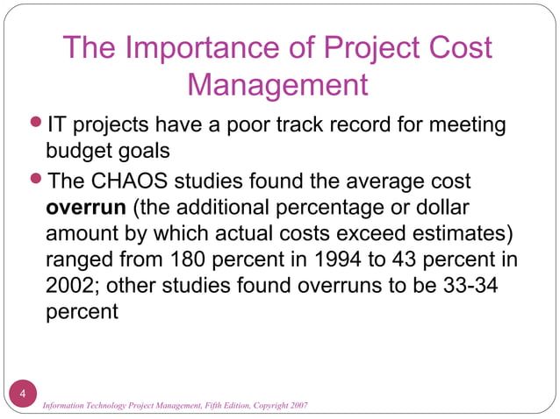

Slide 4


Slide 5
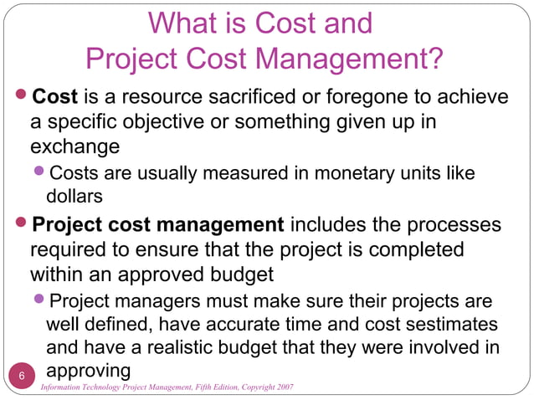

Slide 6
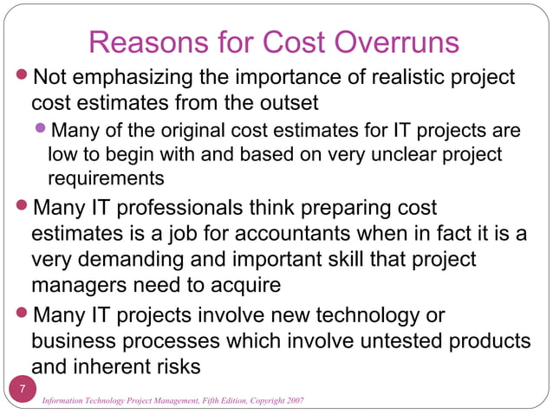

Slide 7
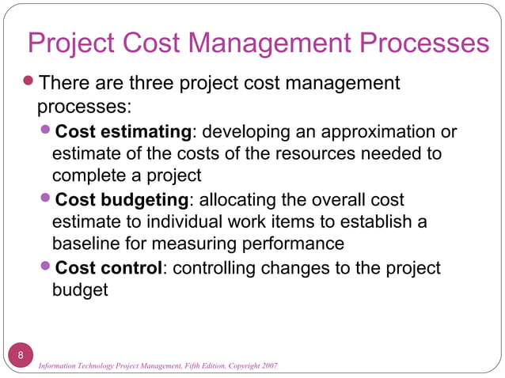

Slide 8
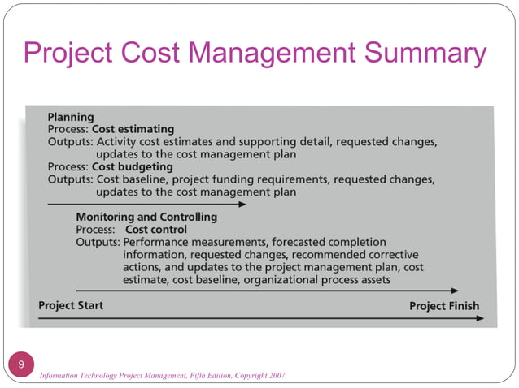

Slide 9
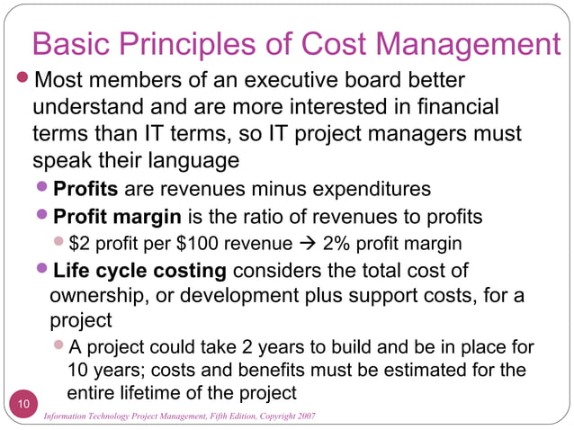

Slide 10
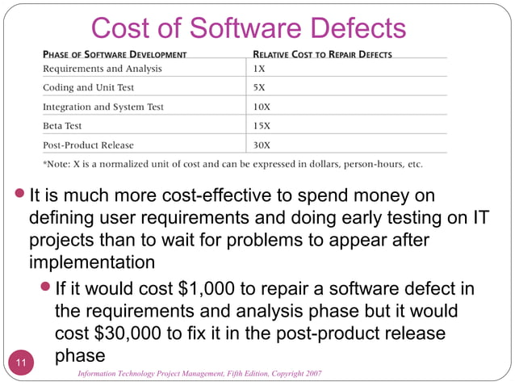

Slide 11
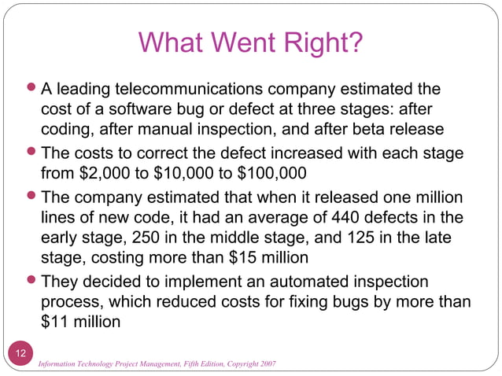

Slide 12
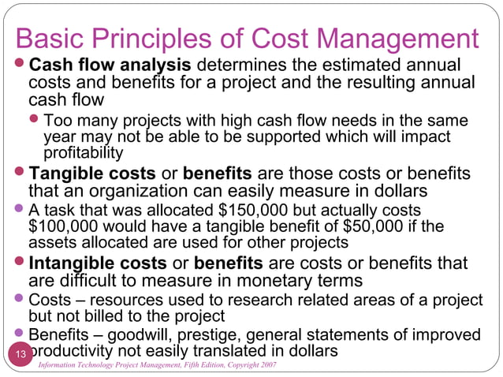

Slide 13
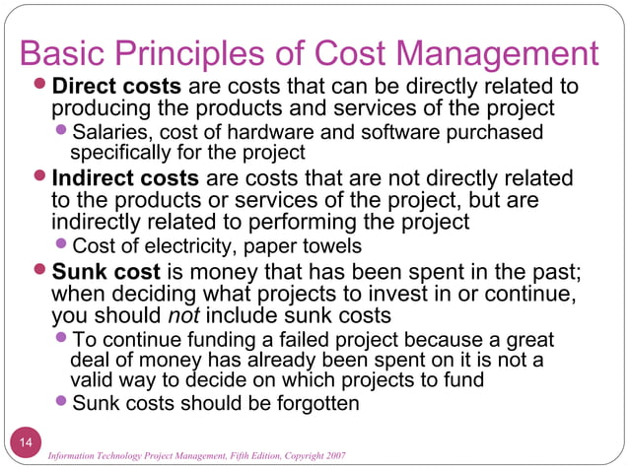

Slide 14
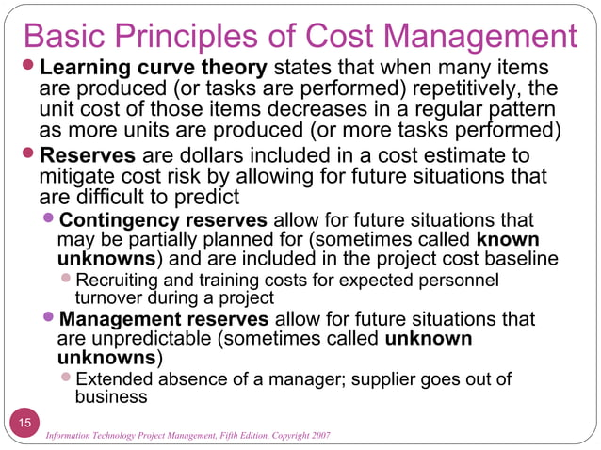

Slide 15
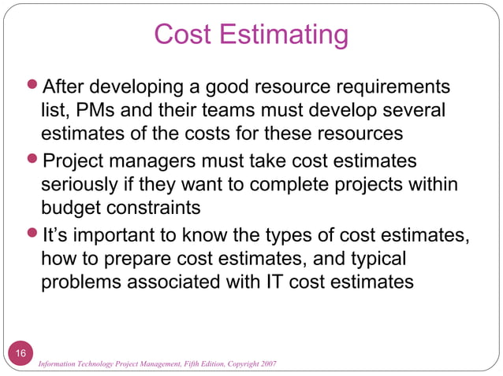

Slide 16
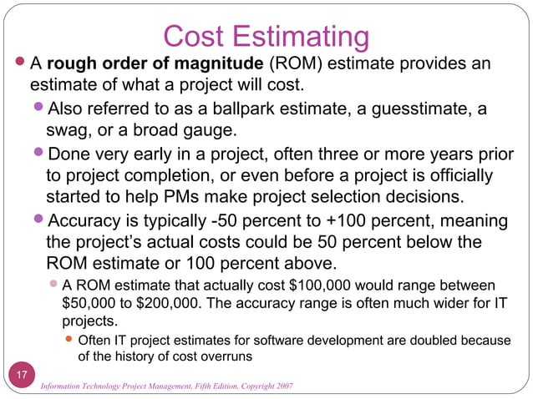

Slide 17
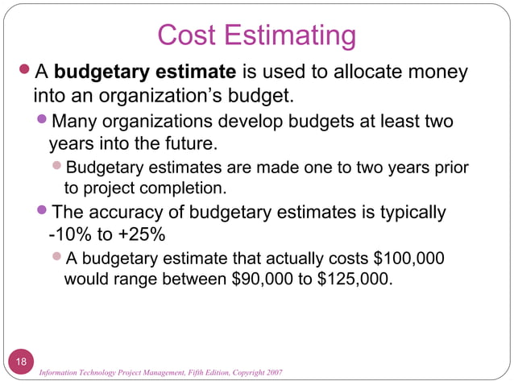

Slide 18
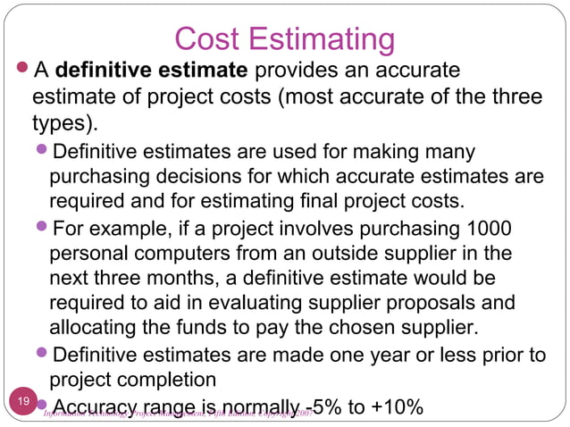

Slide 19
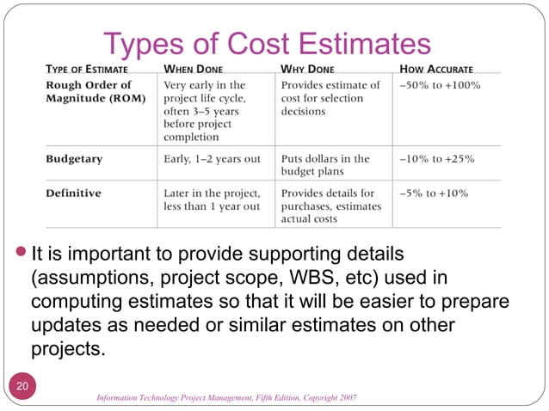

Slide 20
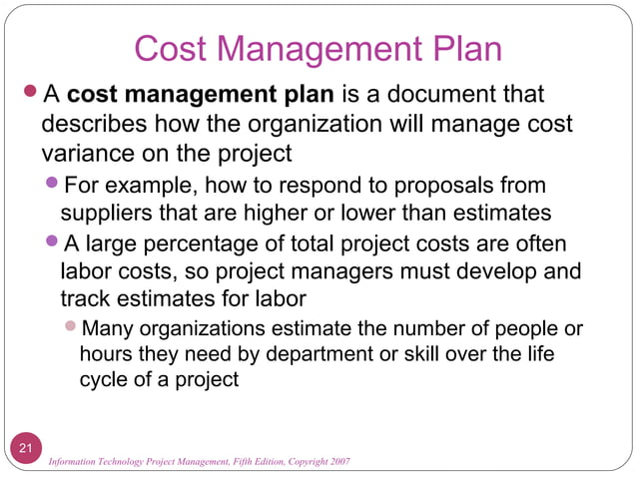

Slide 21
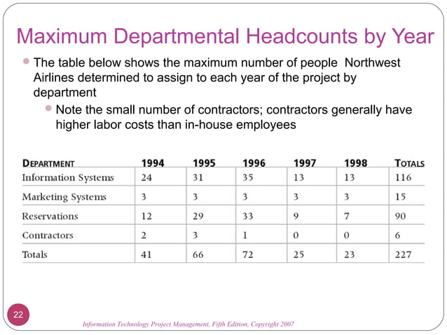

Slide 22
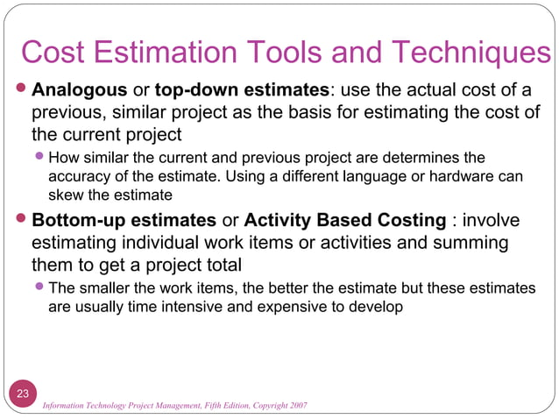

Slide 23
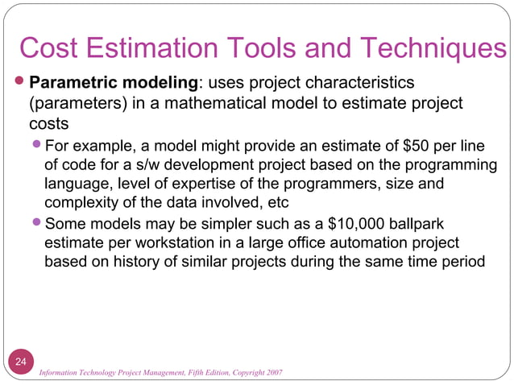

Slide 24
Cost Estimation tools and techniques
Barry Boehm, in his classic work on software effort models, identiﬁed the main ways of deriving estimates of software development effort as:
● algorithmic models, which use ‘effort drivers’ representing characteristics of the target system and the implementation environment to predict effort;
● expert judgement, based on the advice of knowledgeable staff;
● analogy, where a similar, completed, project is identiﬁed and its actual effort is used as the basis of the estimate;

Slide 25
● Parkinson, where the staff effort available to do a project becomes the ‘estimate’;
● price to win, where the ‘estimate’ is a ﬁgure that seems sufﬁciently low to win a contract;
● top-down, where an overall estimate for the whole project is broken down into the effort required for component tasks;
● bottom-up, where component tasks are identiﬁed and sized and these individual estimates are aggregated.

Slide 26
Algorithmic modeling
involves using predefined mathematical equations or algorithms to estimate costs. These algorithms are typically based on historical data, statistical analyses, and other quantifiable parameters.
Key Features: Focuses on applying formulas or computational algorithms
Often used in software development (e.g., COCOMO model).
Requires historical and accurate project data for calibration.
Provides results through defined computational processes.
Example: In software development, the COCOMO (Constructive Cost Model) uses inputs like size of the code (in KLOC), complexity, and other factors to calculate cost.
Effort=𝑎×(Size)^{𝑏}×Multipliers

Slide 27
Parametric models
Parametric modeling involves using parameters (or variables) that have a
statistically established relationship with project costs. This approach often leverages
historical data to determine relationships between project features and costs.
Key Features:
Focuses on establishing cost relationships with one or more measurable attributes.
Parameters could include size, complexity, and duration.
It relies heavily on robust and consistent historical data.
Can be seen as a subset of algorithmic modeling.

Slide 28
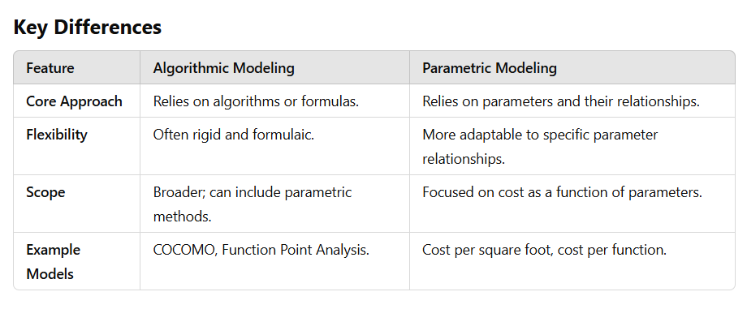
Example: Estimating the cost of constructing a building based on cost per square foot, where the relationship (e.g., $X per square foot) is derived from historical data.

Slide 29
COCOMO- Constructive Cost Model Outline
Introduction
The Basic Model
Equations
When You Should Use It
Limitations
Intermediate Model
Detailed Model

Slide 30
COCOMO: (Constructive Cost Model)
COCOMO is one of the most widely used software estimation models in the world
It was developed by Barry Boehm in 1981
COCOMO predicts the effort and schedule for a software product development based on inputs relating to the size of the software and a number of cost drivers that affect productivity

Slide 31
Boehm postulated that any software development project can be classified into one of the following three categories based on the development complexity:
organic,
semidetached,
and embedded.
In order to classify a product into the identified categories, Boehm not only considered the characteristics of the product but also those of the development team and development environment.
According to Boehm, software cost estimation should be done through three stages: Basic COCOMO, Intermediate COCOMO, and Complete COCOMO.

Slide 32
The Development Modes: Project Characteristics
Organic Mode
A development project can be considered of organic type, if the project deals with developing a well understood application program, the size of the development team is reasonably small, and the team members are experienced in developing similar types of projects.
Semidetached Mode
A development project can be considered of semidetached type, if the development consists of a mixture of experienced and inexperienced staff. Team members may have limited experience on related systems but may be unfamiliar with some aspects of the system being developed.

Slide 33
Cont….
Embedded Mode
A development project is considered to be of embedded type, if the software being developed is strongly coupled to complex hardware, or if the stringent regulations on the operational procedures exist.

Slide 34
 | Project size | Nature of project | Innovation | Deadline of Project
Organic | 2-50 KLOC | Small size, Experienced Developer e.g pay-roll, inventory projects | Little | Not Tight
Semi Detached | 50-300 KLOC | Medium size project, Medium size team e.g data base systems | Medium | Medium
Embedded | Over 300 KLOC | Large Projects, Real Time systems e.g ATM | Significant | Tight

Slide 35
COCOMO: An Assumption
Primary cost driver is the number of Delivered Source Instructions (DSI) or KLOC developed by the project
Basic COCOMO model estimates the software development effort using only a single predictor variable (size in Delivered Source Instructions- DSI or KLOC) and three software development modes

Slide 36
Effort=𝑎×(Size)^{𝑏}×Multipliers
Where:
a: A constant that depends on the type of project (e.g., organic, semi-detached, embedded).
b: An exponent that reflects the diseconomies of scale.
Size: The estimated size of the project in terms of lines of code (KLOC).
Multipliers: A product of cost drivers like team capability, project complexity, etc.

Slide 37
Example:
Let's calculate the effort estimate for a project with the following details:
a=2.4 (Organic project type)
b=1.05
Size=50 KLOC (thousands of lines of code)
Multipliers=1.15 (Moderate cost drivers)
Substitute these values into the formula:
Effort=2.4×(50)^{1.05}×1.15
Calculate (50)^{1.05}
50^{1.05}≈56.78
Multiply by a:
2.4×56.78≈136.27
Multiply by the multipliers:
136.27×1.15≈156.71 The effort required for the project is approximately 156.71 person-months.
This means the project would require around 156.71 months of work for one person, or it could be distributed among a team.

Slide 38
Economies of Scale: For smaller, simpler projects, effort increases less dramatically with size, so b is smaller.
Diseconomies of Scale: For larger, more complex projects, b is larger because coordination,
integration, and communication costs grow disproportionately as size increases.
The value of b (the scaling factor) in the effort estimation formula depends on the type of project and the specific model being used.
In the COCOMO I model (original version), b was fixed based on the type of project:
Organic (small, simple projects with a well-understood domain): b≈1.05
Semi-detached (medium complexity): b≈1.12
Embedded (large, complex, or real-time systems): b≈1.20

Slide 39
Basic COCOMO Model: When Should You Use It
Basic COCOMO is good for quick, early, rough order of magnitude estimates of software costs

Slide 40
In software effort estimation models like COCOMO, the time to develop (TDEV), often referred to as the development schedule, is calculated using the following formula:
TDEV=c×(Effort)^{d}
Where:
TDEV: Development time (usually in months).
c: A constant specific to the type of project (e.g., organic, semi-detached, embedded).
Effort: Effort required, calculated in person-months from the effort formula.
d: A scaling factor that reflects the relationship between effort and development time.

Slide 41
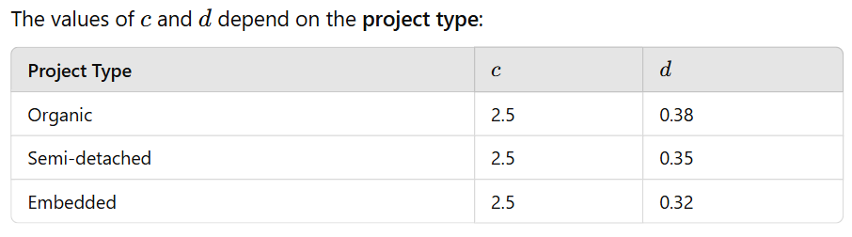

Slide 42
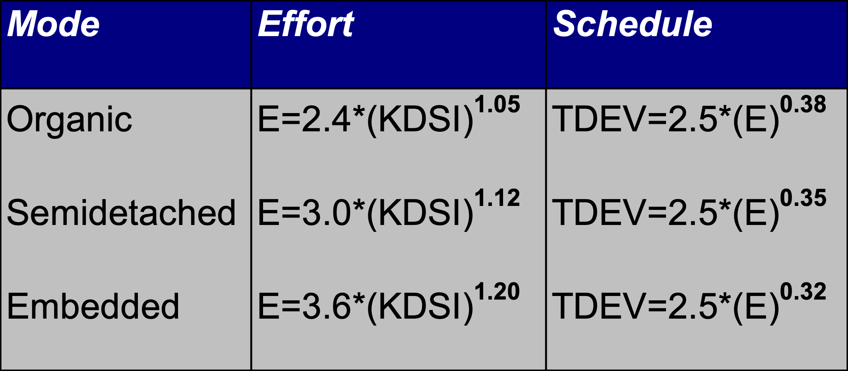
Basic COCOMO Model: Equations
E=Effort, TDEV= Estimated time to develop the software
Notes:
Effort in man-months
A COCOMO man-month consists of 152 hours of working time
KDSI is the Thousand Delivered Source Instructions
TDEV is the number of months estimated for software development

Slide 43
Basic COCOMO Model: Limitations
Assumes that effort and development time are functions of product size alone
Its accuracy is necessarily limited because of its lack of factors which have a significant influence on software costs

Slide 44
Basic COCOMO Model: An Example
We have determined our project has following characteristics.
We estimate our project will have 32,000 Delivered Source Instructions. Assume that the average salary of software engineers be Rs. 15,000/- per month. Using the formulas, we can estimate:
Effort = 2.4 х (32) ^{1.05} = 91 MM
Nominal development time = 2.5 х (91) ^{0.38} = 14 months
Average Staffing = 91 MM /14 months = 7 FSP(Full time equivalent software personnel)
Cost required to develop the product = 14 х 15,000 = Rs. 210,000/-
Notes:
FSP = Full-time equivalent Software Personnel, a measure of the equivalent number of people working on the project at a given time.

Slide 45
Intermediate COCOMO Model
The Intermediate Model estimates the software development effort by using fifteen cost driver variables besides the size variable used in Basic COCOMO

Slide 46
Intermediate COCOMO Model
Four areas for drivers
Product itself/ Product attributes:
inherent complexity of the product, reliability requirements etc.
Computer/ Platform attributes:
execution speed required, storage space required, etc.
Personnel attributes:
experience level, programming capability, analysis capability, etc.
Project itself or Development environment:
development facilities available to developers

Slide 47
Intermediate Model: Cost Driver Categories
Product Attributes
RELY --- Required Software Reliability
The extent to which the software product must perform its intended functions satisfactorily over a period of time.
DATA --- Data Base Size
The degree of the total amount of data to be assembled for the data base.
CPLX --- Software Product Complexity
The level of complexity of the product to be developed.
Notes:
RELY --- Required Software Reliability DATA --- Data Base Size CPLX --- Software Product Complexity

Slide 48
Intermediate Model: Cost Driver Categories
Computer Attributes
TIME --- Execution Time Constraint
The degree of the execution constraint imposed upon a software product.
STOR --- Main Storage Constraint
The degree of main storage constraint imposed upon a software product.
VIRT --- Virtual Machine Volatility
The level of the virtual machine underlying the product to be developed.
TURN --- Computer Turnaround Time
The level of computer response time experienced by the project team developing the product.
Notes:
TIME --- Execution Time Constraint STOR --- Main Storage Constraint VIRT --- Virtual Machine Volatility
TURN --- Computer Turnaround Time

Slide 49
Intermediate Model: Cost Driver Categories
Personnel Attributes
ACAP --- Analyst Capability
The level of capability of the analysts working on a software product.
AEXP --- Applications Experience
The level of applications experience of the project team developing the software product.
PCAP --- Programmer Capability
The level of capability of the programmers working on the software product.
VEXP --- Virtual Machine Experience
LEXP --- Programming Language Experience
Notes:
ACAP --- Analyst Capability AEXP --- Applications Experience PCAP --- Programmer Capability

Slide 50
Intermediate Model: Cost Driver Categories
Project Attributes
MODP --- Modern Programming Practices
The degree to which modern programming practices (MPPs) are used in developing software product.
TOOL --- Use of Software Tools
The degree to which software tools are used in developing the software product.
SCED --- Required Development Schedule
The level of schedule constraint imposed upon the project team developing the software product.
Notes:
MODP --- Use of Modern Programming Practices TOOL --- Use of Software Tools SCED --- Schedule Constraint

Slide 51
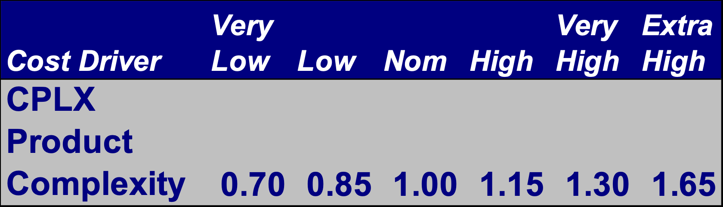
Intermediate Model: Effort Multipliers
Table of Effort Multipliers for each of the Cost Drivers is provided with ranges depending on the ratings

Slide 52
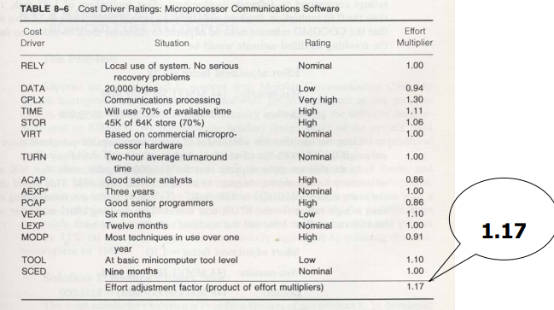

Slide 53
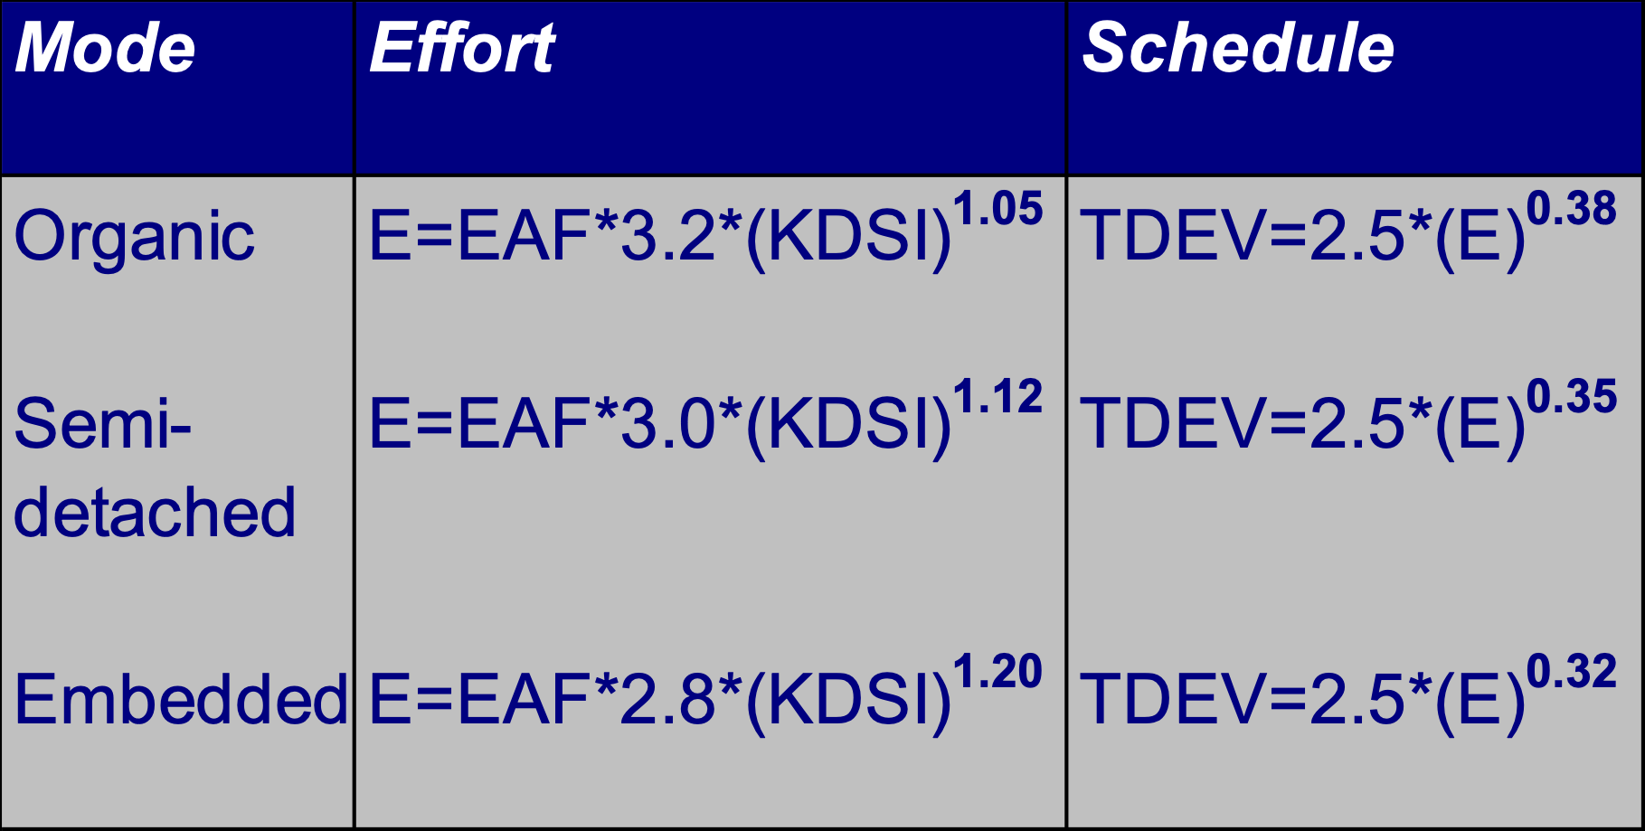
Intermediate Model: Equations
The Effort Adjustment Factor (EAF) is simply the product of the Effort
Multipliers corresponding to each of the cost drivers for your project.
Notes:
The Intermediate Model use an Effort Adjustment Factor (EAF) and slightly different coefficients for the effort equations than the Basic model.

Slide 54
Intermediate Model: When Should You Use It
The Intermediate Model can be applied across the entire software product for easily and rough cost estimation during the early stage
or it can be applied at the software product component level for more accurate cost estimation in more detailed stages

Slide 55
Intermediate Model: An Example
Project A is to be a 300 KLOC semi-detached software. It is in a mission critical area, so the reliability is high (RELY=high=1.15). Then we can estimate:
Effort = 1.15*3.0*(32)^{1.12} = 167 man-months
Schedule = 2.5*(167)^{0.35} = 15 months
Average Staffing = 167 MM/15 months = 11 FSP

Slide 56
Detailed COCOMO Model: How is it Different
Software systems are not homogeneous
Most large systems comprised of several smaller subsystems
Phase-sensitive Effort Multipliers The effort multipliers for every cost drivers are different during the software development phases
Module-Subsystem-System Hierarchy The software product is estimated in the three level hierarchical decomposition. The fifteen cost drivers are related to module or subsystem level
Notes:
These multipliers are used to determine the amount of effort required to complete each phase.

Slide 57
Detailed COCOMO Model: Equations
Detailed Model uses the same equations for estimations as the Intermediate Model
Detailed Model uses a very complex procedure to calculate estimation. The procedure uses the DSIs for subsystems and modules, and module level and subsystem level effort multipliers as inputs

Slide 58
Detailed COCOMO Model: When Should You Use It?
The Detailed Model can estimate the staffing, cost, and duration of each of the development phases, subsystems, modules
It allows you to experiment with different development strategies, to find the plan that best suits your needs and resources

Slide 59
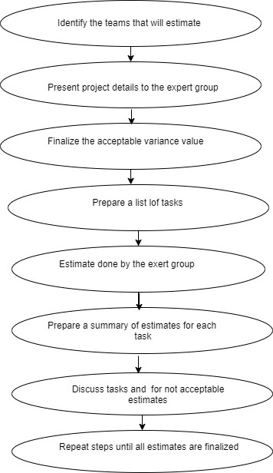
Delphi Technique
The Delphi technique is a consensus-based estimation method used in Software Project Management (SPM) and various other fields.
It involves a group of experts who participate in a series of rounds to converge on a consensus estimate.
Here's how the Delphi technique is typically applied in software project management:

Slide 60
Task | Max. Estimation hours | Min. Estimation hours | Percentage of Variance | Accepted or not (A/ NA)
CBA | 20 | 15 | 25 | A
HLD | 50 | 30 | 40 | NA
Challenges and Considerations:
Resource Intensive: The process may be time-consuming, especially if multiple rounds are conducted.
Dependency on Expertise: The accuracy of estimates depends on the expertise and knowledge of the participating experts.
Potential for Groupthink: Even with anonymity, experts might be influenced by perceived majority opinions.
The Delphi technique is particularly useful in situations where traditional estimation methods may be challenging due to uncertainties, lack of historical data, or the need for expert judgment. It helps bring together diverse perspectives and knowledge to achieve more accurate and reliable estimates in software project management.

Slide 61
The Delphi technique is particularly useful in situations where traditional estimation methods may be challenging due to uncertainties, lack of historical data, or the need for expert judgment. It helps bring together diverse perspectives and knowledge to achieve more accurate and reliable estimates in software project management.

Slide 62
Summary
Cost estimation models are not a substitute for a detailed estimate by task by project management
Cost estimation models highly depend on the user’s knowledge of application domain, analysis ability and the understanding of the cost model itself
The process of meeting the estimate is equally critical to the process of making the estimate

